Slide 1
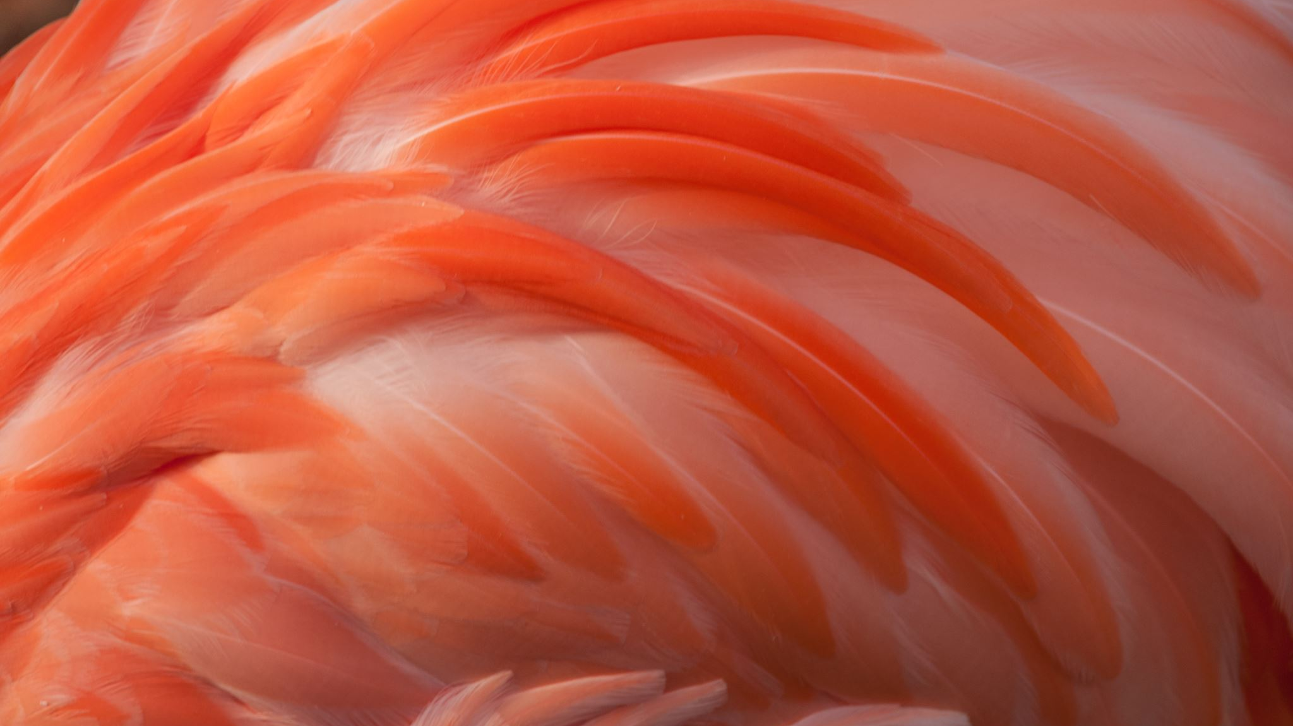
DATATYPES IN MONGO DB
NAME : VARADHA . N
UID : 161101
MAIL ID : varadha.nair@ust.com
DATE : 10/12/2020

Slide 2
DATA TYPES IN MONGO DB
There are different types of data types.
Text
Boolean
Number
NumberInt
NumberLong
NumberDecimal
ObjectId
ISODate
Embedded Document
Array

Slide 3
> db.userData.insertOne({name:"Varadha",age:NumberInt(25),mobile:NumberLong(9874561233),location:{lang:NumberDecimal(18.539),lat:NumberDecimal(69.9629)},graduated:Boolean(true),hobbies:["Drawing","Painting"],createdAt:new Date()})
{
"acknowledged" : true,
"insertedId" : ObjectId("5fd4fac84f1107d968901fb1")
}
>

Slide 4
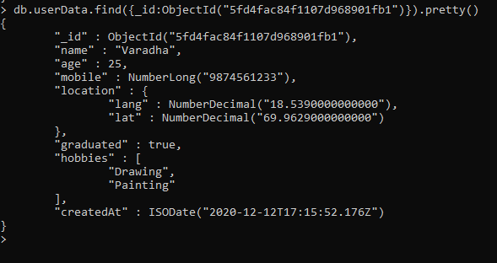
> db.userData.find({_id:ObjectId("5fd4fac84f1107d968901fb1")}).pretty()
{
"_id" : ObjectId("5fd4fac84f1107d968901fb1"),
"name" : "Varadha",
"age" : 25,
"mobile" : NumberLong("9874561233"),
"location" : {
"lang" : NumberDecimal("18.5390000000000"),
"lat" : NumberDecimal("69.9629000000000")
},
"graduated" : true,
"hobbies" : [
"Drawing",
"Painting"
],
"createdAt" : ISODate("2020-12-12T17:15:52.176Z")
}
>

